Slide 1



Hands-on:
Microbial community analysis using the ampvis2 package
MiDAS course 2025

Slide 2

Structure of the hands-on
Install R and Rstudio (if not done)
Install ampvis2 in Rstudio
Download data from github (add address)
Load data
Explore data!

Slide 3
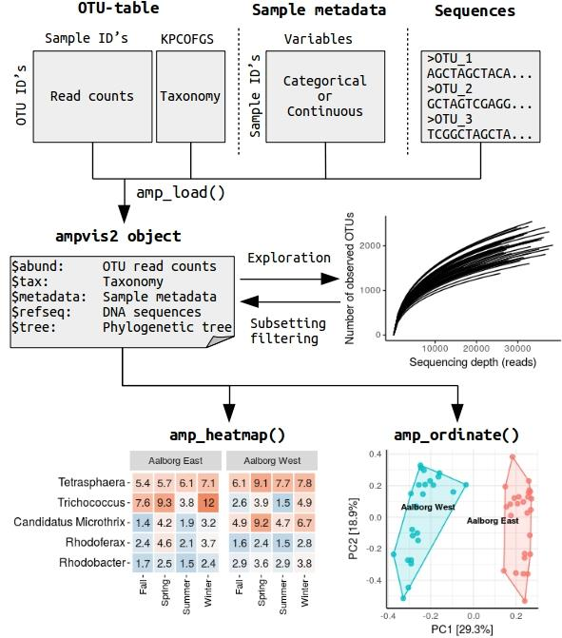
What can ampvis2 do?
- Handling amplicon data
- Visualize amplicon data
Check out and explore all the nice documentation:
https://kasperskytte.github.io/ampvis2/articles/ampvis2.html

Slide 4
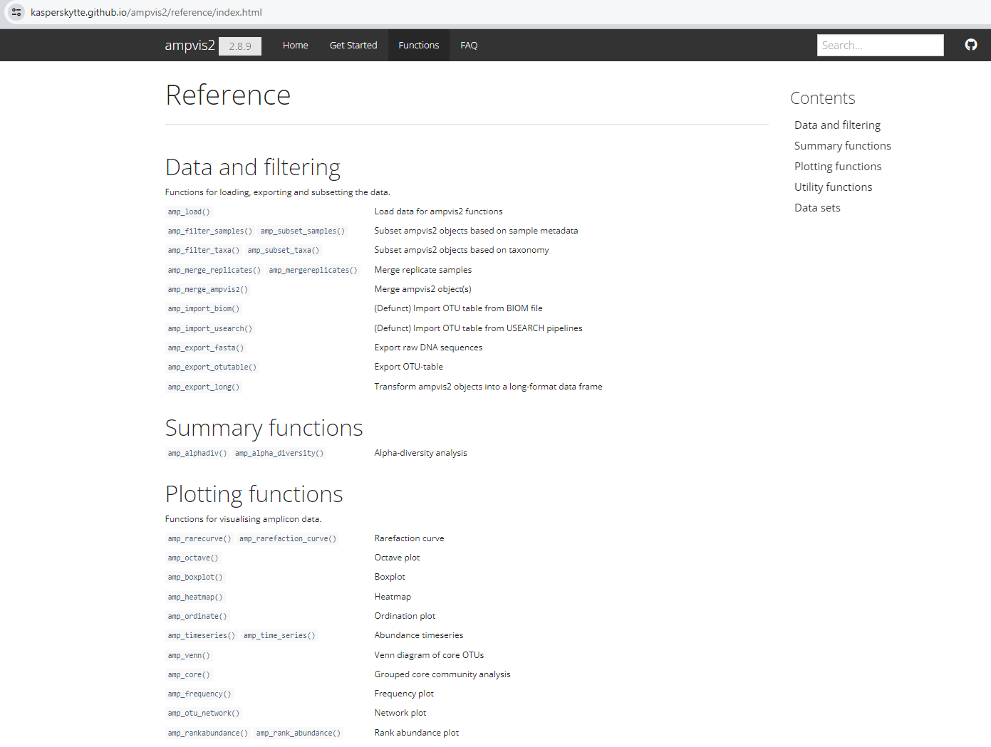
Open the website
Click on the functions!

Slide 5
Open the website
Select a function to see how to use function

Slide 6
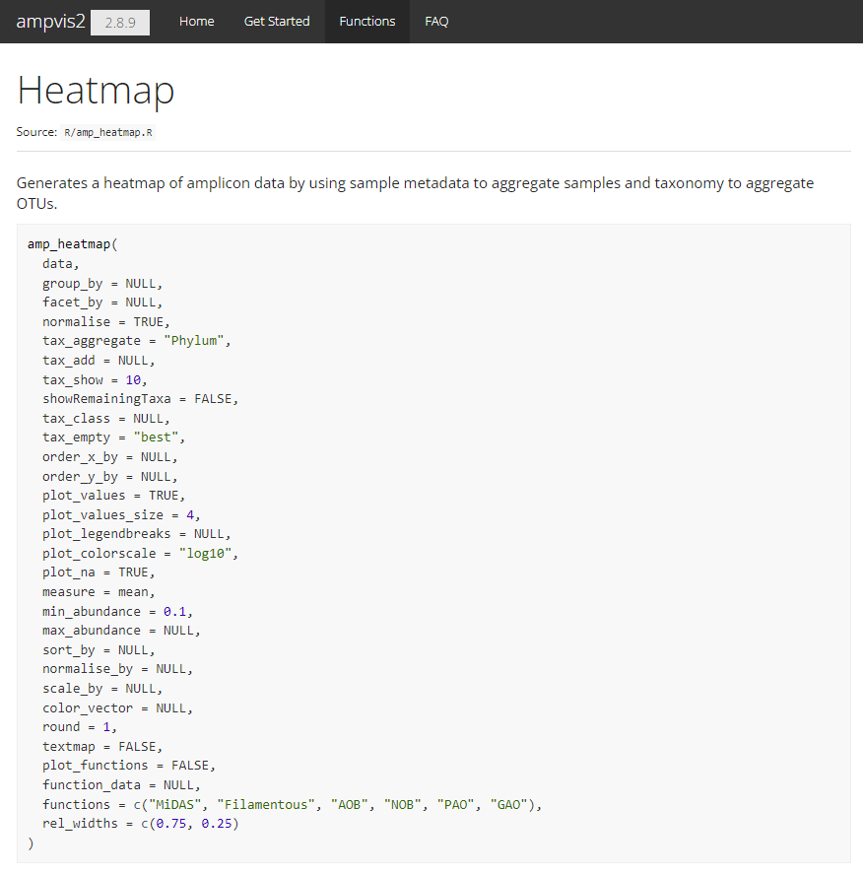
Open the website
Check out and play with all the settings

Slide 7
Data exploration
Basic QC analysis
Evaluation of negative controls: As we often work with tiny amounts of DNA contamination often occur. This could be from other samples, yourself and even the kits/reagents we use. Hence, it is important to take a critical look at the negative controls compared to the real samples. However, in the interest of time you can assume that problematic samples have been removed from the data set.
Rarefaction curves: Evaluate if we have sequenced enough reads per sample to represent the diversity in the samples. This is often a subjective decision, but when the curve flattens it indicates we rarely observe new ASVs, indicating that we have captured most of the diversity in the sample. Often you have to compromise with the number of reads in order to keep more samples in your analysis.
Subset to a minimum number of reads per sample: remove samples with low reads.
Other?
https://kasperskytte.github.io/ampvis2/articles/ampvis2.html

Slide 8
Data exploration
Explore metadata
Get an overview of the samples you are looking at.
How many WWTPs do we have?
Do we have longitudinal data or spatial data?
How many samples per WWTP do we have?
Create helper columns in the metadata.
e.g., Month column
Other?
https://kasperskytte.github.io/ampvis2/articles/ampvis2.html

Slide 9
Data exploration
Explore sequencing table
What are the minimum and maximum number of reads in the dataset?
What are the minimum and maximum number of reads in Ribe?
Should we rarefy our dataset?
Rarefy the dataset
Should we normalise our dataset?
Normalise the dataset
Now we are ready to start some fun analysis!
https://kasperskytte.github.io/ampvis2/articles/ampvis2.html

Slide 10
Break and R support

Slide 11
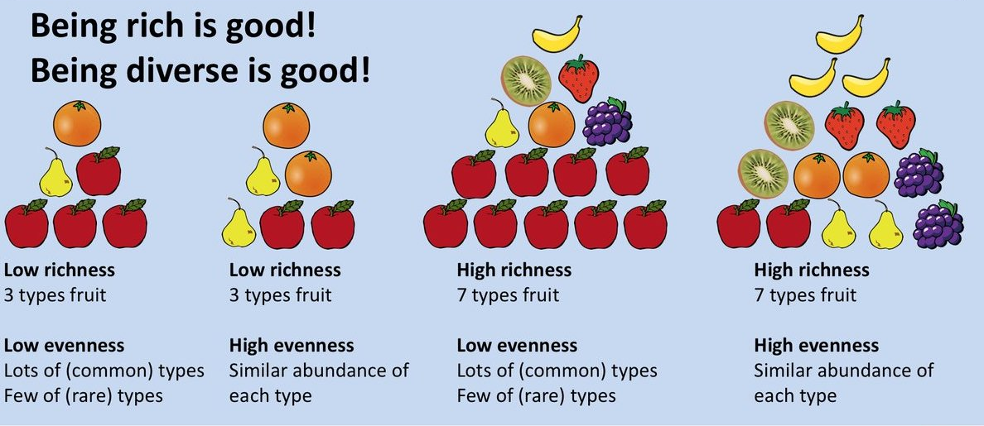
Data exploration
Alpha diversity: Measure of diversity within a sample
Source: Finotello. Briefings Bioinformatics. 2016.
Calculate the alpha diversity (ObservedOTU, Shannon, Simpson)
HINT: Try the amp_alpha_diversity() function
Investigate the diversity across samples, WWTPs, and months
https://kasperskytte.github.io/ampvis2/articles/ampvis2.html

Slide 12
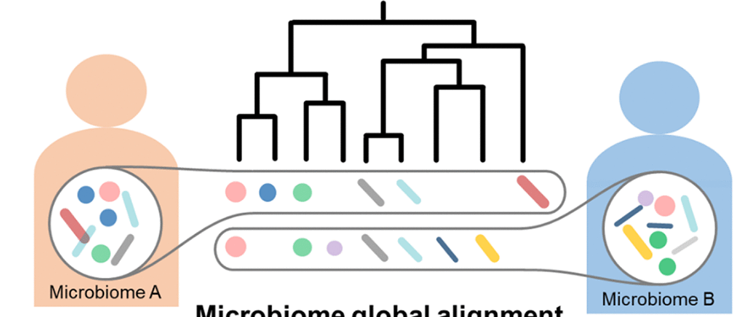
Data exploration
Beta diversity: Measure of microbiome similarity between two or more samples
Su, X., 2021. mSystems 6. https://doi.org/10.1128/msystems.00363-21
Make an ordination plot of all samples
HINT: Try the amp_ordinate() function
Discuss what you observe from the plot
Try to color and frame by different metadata variables
HINT: Try the sample_color_by and sample_color_frame options
(Bonus) Try to explore the effect at different filtering and distance matrices
https://kasperskytte.github.io/ampvis2/articles/ampvis2.html

Slide 13
Data exploration
Beta diversity: Measure of microbiome similarity between two or more samples
Su, X., 2021. mSystems 6. https://doi.org/10.1128/msystems.00363-21
Make an ordination plot of all samples
HINT: Try the amp_ordinate() function
Discuss what you observe from the plot
Try to color and frame by different metadata variables
HINT: Try the sample_color_by and sample_color_frame options
(Bonus) Try to explore the effect at different filtering and distance matrices
https://kasperskytte.github.io/ampvis2/articles/ampvis2.html

Slide 14
Data exploration
Most abundant bacteria
Which Which are the 25 most abundant genera across all samples?
HINT: Try the amp_heatmap() function
HINT: Try the amp_boxplot() function
Try different grouping of the data (group_by)
Which are the 25 most abundant genera in each WWTP?
Try facet_by
Which are the 25 most abundant genera in each WWTP and month?
Examine the effect of tax_show, tax_aggregate, showRemainingTaxa
Which genera within Proteobacteria are the most abundant across all samples?
HINT: Try the amp_subset_taxa() function
Try making the heatmap at the different taxonomic levels
https://kasperskytte.github.io/ampvis2/articles/ampvis2.html

Slide 15
Data exploration
Bonus! Explore most abundant bacteria using SILVA taxonomy
Try making the heatmap at the different taxonomic levels. How is it compared to MiDAS taxonomy
Discuss importance of the database, why is it important to get good taxonomic classifications?
https://kasperskytte.github.io/ampvis2/articles/ampvis2.html

Slide 16
Break and R support

Slide 17
Data exploration
Core community: set of bacteria characteristic for given environment (taxa shared across multiple samples )
core species
unique/transient species
XXXxxxx
HINT: Try the amp_ordinate() function
XXXxxxx
XXXxxxx variables
HINT: Try the sample_color_by and sample_color_frame options
(Bonus)
https://kasperskytte.github.io/ampvis2/articles/ampvis2.html

Slide 18
Data exploration
Time series
Functional groups…
https://kasperskytte.github.io/ampvis2/articles/ampvis2.html

